Slide 1

Retail Industry
Project
AI-based System to Predict Product Demand and Optimize Restocking
Group B

Slide 2
Group Name: Group B
Student Name | Student ID
Dhanush Chandar Sivakumar | 500228646
Rithwik Prem | 500220919
Sweatha Palani | 500221321
Oluwakanyinsola Adebanjo | 500228268
Rajesh Jayaraman | 500228177

Slide 3


Introduction
To build an AI-based inventory optimization system that predicts demand and helps with restocking, aiming to reduce holding costs and ensure product availability.

Slide 4

Problem Definition
Problem Statement: Retailers often struggle with overstocking and understocking. The aim of this project is to develop a system that predicts demand and optimizes restocking to reduce holding costs and prevent stockouts.
Impact: How the system will contribute to improving operational efficiency and inventory management in retail.

Slide 5
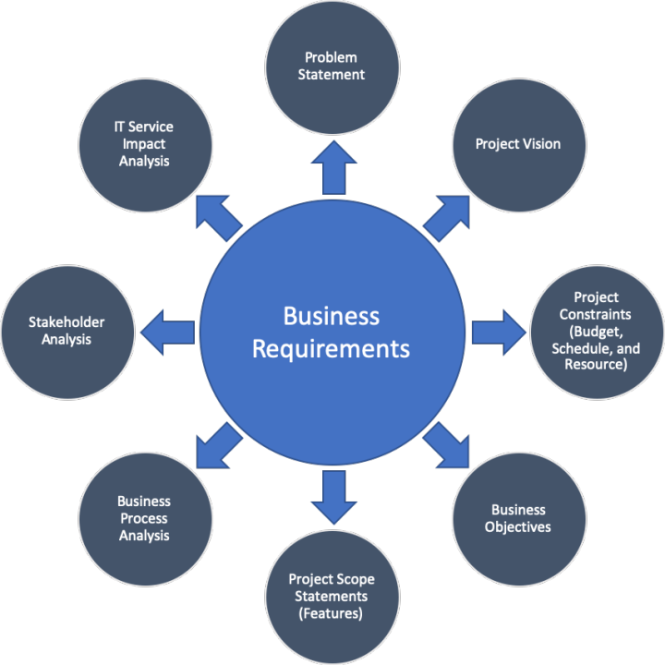
Business Requirement

Slide 6
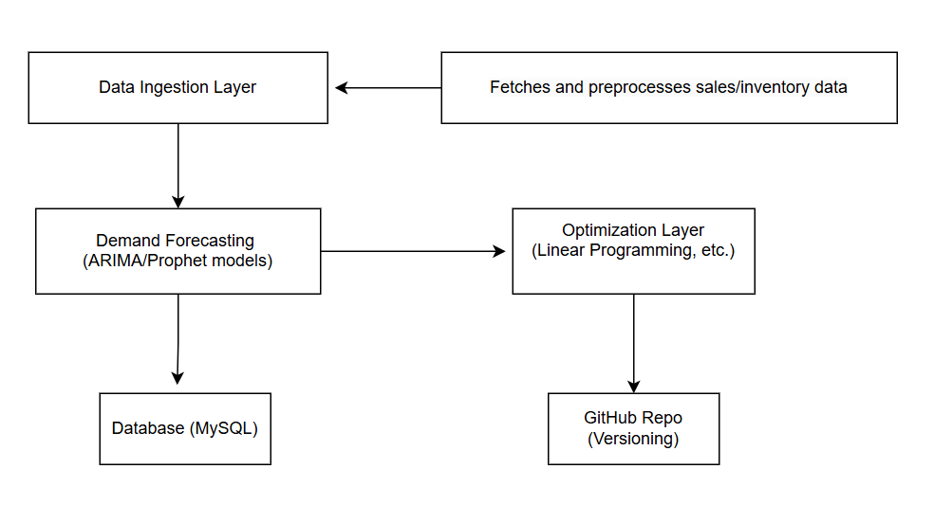
System Architecture Design

Slide 7
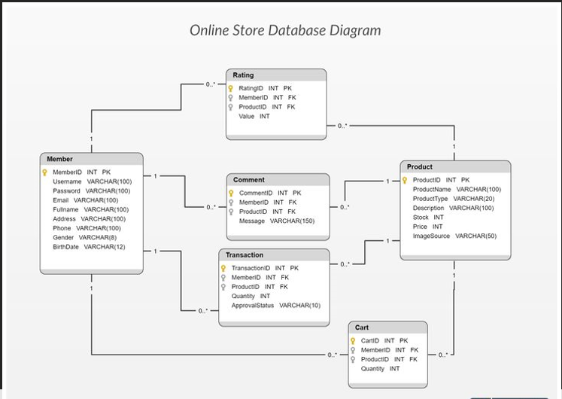

Database Design

Slide 8

Data Preprocessing Plan
Handling missing data
Normalizing data for model input.
Feature engineering

Slide 9

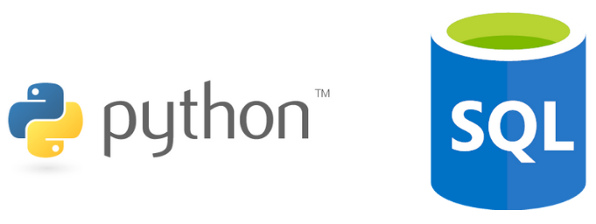

Environment Setup
Python
SQL
Github
GitHub Repository link : GitHub Link-Group B

Slide 10

Initial Challenges
Data availability and quality.
Selecting the right forecasting model.
Handling Seasonality and Trends
Scalability of the System
Integrating Optimization with Forecasting

Slide 11

Next Steps
Developing and testing the demand forecasting models.
Optimizing the system for restocking.
Gathering additional data to refine predictions.

Slide 12

Conclusion
In this phase of the Inventory Optimization project, we successfully completed the initial planning and design. We defined the problem, gathered the necessary data, designed the system architecture, and set up our database schema.
Our AI-based system will use demand forecasting and optimization techniques to help retailers make smarter restocking decisions, reducing inventory holding costs and improving product availability.

Slide 13

Thank
You!

